Slide 1
NANDHA ENGINEERING COLLEGE Department of Information Technology
Real-Time Collaborative Dev Platform
MENTOR:
1. Anand.R (AP/IT)
Team Details:
1. Vishnuraju.V (22IT056) 2. Jotheeswaran.M (22ITL02)
3. Vigneshwaran.M (22ITL08)

Slide 2
Abstract
Traditional development tools force fragmented workflows with no true real-time collaboration, causing productivity loss and merge conflicts.
A unified cloud IDE combining GitHub's version control, VS Code's editing power, and Replit's instant execution in one platform.
CRDT-based real-time collaboration enables conflict-free simultaneous editing with live cursor tracking and instant synchronization.
Eight core modules: Authentication, Project Management, Real-Time Collaboration, Communication, Code Execution, Version Control, AI Assistant, and Deployment.
MongoDB Atlas provides cloud-native document storage with real-time Change Streams for live collaboration data.
Zero merge conflicts via CRDT, zero setup time via cloud containers, and sub-50ms sync latency for real-time feel.

Slide 3
Introduction
Software development has gone global and distributed, yet collaboration tools remain stuck in single-user, asynchronous workflows.
Developers waste hours context-switching between IDEs, Git, Slack, and video calls just to write code together.
No existing tool combines professional editing, real-time collaboration, secure execution, and version control in one platform.
Powered by React.js, Node.js, WebSockets, Docker, Redis, and MongoDB Atlas for cloud-native scalability.
Eliminate fragmented workflows and merge conflicts while delivering a secure, scalable ecosystem for distributed teams
The "Google Docs gap" exists—documents edit collaboratively, but code remains locked in single-user editors..

Slide 4
Requirements
Software Requirements: System Requirements:
Frontend: React.js 64-bit Operating System
Backend: Node.js with Express.js Node.js installed (v18 or above recommended)
Real-time Communication: WebSockets (Socket.IO) Docker Engine installed and running
Database / Cache: Redis Modern web browser with JavaScript enabled
Hardware Requirements:
Processor: Intel i3 or equivalent
RAM: 4 GB
Storage: 10 GB free disk space
Internet: Stable broadband connection

Slide 5
Existing System
Disadvantages of Existing System:
No real-time collaborative code editing
Frequent merge conflicts during integration
Delayed feedback between team members
Communication and coding tools are separated
Difficult for remote teams to coordinate live
Manual environment setup required for each developer
Limited visibility of other developers’ activities

Slide 6
Proposed System
Solution:
Enabling real-time multi-user code editing
Providing instant synchronization using WebSockets
Integrating communication (chat) within the coding workspace
Reducing merge conflicts through live collaboration
Novelty:
Live cursor presence and user activity awareness
Built-in secure sandbox for multi-language code execution
Scalable architecture supporting multiple concurrent rooms
Google Docs–style real-time coding experience

Slide 7
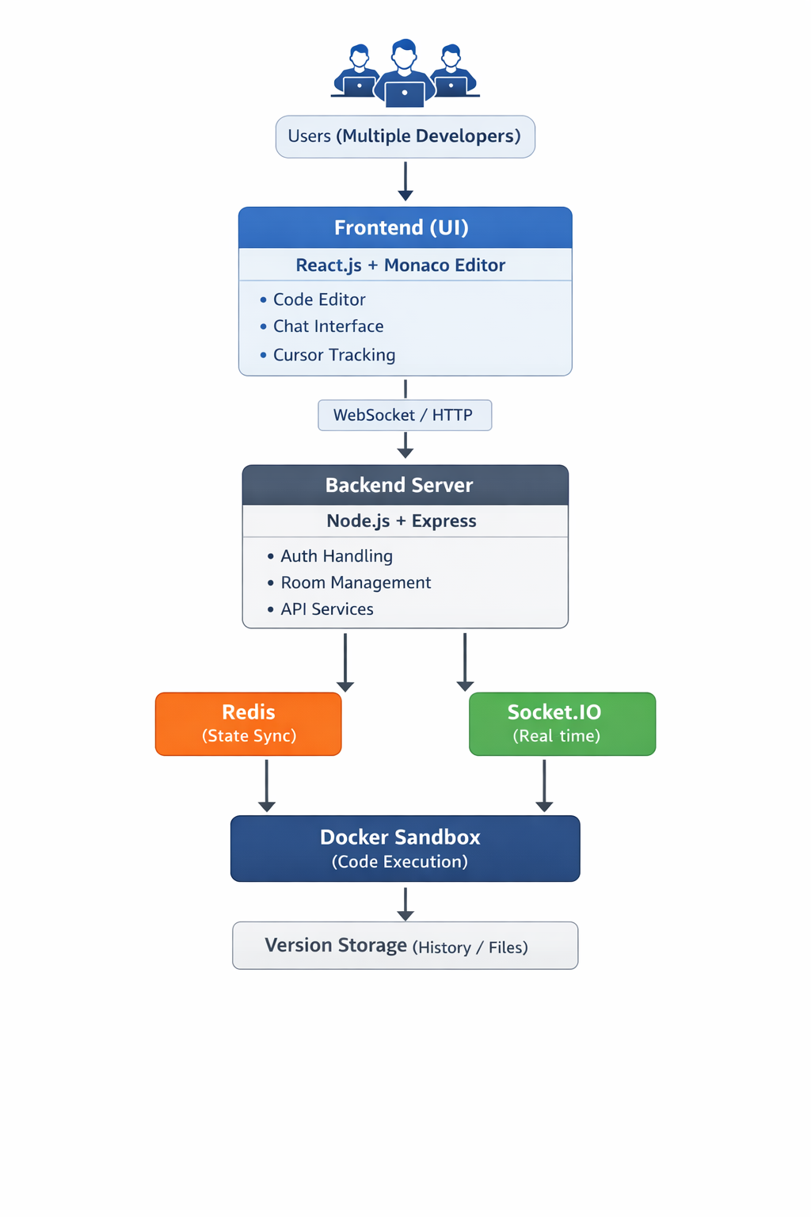
Block Diagram

Slide 8
Module List
Module 1 – User Authentication & Management Handles user registration, login, logout, and session management. Ensures only authorized users can access collaborative rooms and maintains user identity during real-time sessions.
Module 2 – Collaborative Code Editor
Provides the main coding interface using Monaco Editor. Supports real-time multi-user editing, syntax highlighting, auto-completion, and live cursor tracking so all users can see each other’s changes instantly.
Module 3 – Real-Time Communication (WebSocket/Socket.IO)
Manages live data exchange between clients and server. Synchronizes code changes, cursor movements, and chat messages instantly across all connected users in a room.
Module 5 – In-App Chat System
Provides real-time messaging between collaborators within the coding environment. Helps teams discuss code changes without leaving the platform.

Slide 9
Literature Review
Year | Authors | Paper Title | Key Contribution
2025 | Antara Armarkar et al. | Real-Time Collaborative Coding Platform with WebRTC | Proposed synchronized editing with Docker sandboxing and CRDT-based low-latency collaboration.
2024 | N.V. Raja Sekhkar Reddy et al. | Real Time Collaborative Code Editor | Designed an interview-focused collaborative environment with video and code execution.
2023 | Li Feng et al. | CoPrompt: Collaborative Natural Language Programming | Proposed mechanisms to improve awareness and coordination in collaborative programming.

